Slide 1

CLOUD WEB SERVICES
Unit 4: AWS Storage
Version Code: CWS1
Released Date: 3-Dec-2018

Slide 2
AWS Storage
AIM:
To familiarize students about AWS Storage services and brief description of AWS RDS.
2

Slide 3
AWS Storage
Objectives:
The objectives of this module are to understand:
S3 bucket and creating bucket, hosting static website.
Elastic Block Storage [EBS].
How to store archived data in AWS.
How to store and manage unstructured data in AWS.
Introduction to RDS and how to launch a RDS instance.
2

Slide 4
AWS Storage
Outcome:
The outcome of this module are to explain/describe:
We can store the objects in S3 bucket and host static website.
Elastic Block Storage [EBS] helps to create volumes and take snapshots of VM.
Glacier storage service stores the archived data in AWS with less cost.
Dynamo DB is used for NoSQL data in AWS.
RDS engines and how to launch a RDS instance.
2

Slide 5
AWS Storage
Content
Understanding S3 bucket and creation
Hosting static Website on S3 Bucket
Elastic Block Storage [EBS] Volumes and Snapshots
Glacier storage service
Dynamo DB
AWS RDS
2

Slide 6
AWS Storage
Amazon storage service
Cloud storage is a critical component of cloud computing, holding the information used by applications. Big data analytics, data warehouses, Internet of Things, databases, and backup and archive applications all rely on some form of data storage architecture. Cloud storage is typically more reliable, scalable, and secure than traditional on-premises storage systems.
AWS offers a complete range of cloud storage services to support both application and archival compliance requirements. Select from object, file, and block storage services as well as cloud data migration options to start designing the foundation of your cloud IT environment.
2

Slide 7
AWS Storage
Amazon storage service
A scalable, durable platform to make data accessible from any Internet location, for user-generated content, active archive, server less computing, Big Data storage or backup and recovery.
Amazon S3
Highly affordable long-term storage that can replace tape for
archive and regulatory compliance.
Glacier storage
Local storage for Amazon EC2, for relational and No SQL databases, data warehousing, enterprise applications, Big Data processing, or backup and recovery.
Elastic block storage
Cloud data migration
A portfolio of services to help simplify and accelerate moving data of all types and sizes into and out of the AWS cloud.
A file system interface and file system access semantics to make data
available to one or more EC2 instances, enterprise applications, media
Amazon elastic file system
processing workflows and Big Data analytics workloads
7

Slide 8
AWS Storage
What is s3?
Amazon Simple Storage Service is storage for the Internet. It is designed to make web-scale computing easier for developers.
Amazon S3 has a simple web service interface that you can use to store and retrieve any amount of data, at any time, from anywhere on the web. It gives any developer access to the same highly scalable, reliable, fast, inexpensive data storage infrastructure that Amazon uses to run its own global network of websites.
8

Slide 9
AWS Storage
Advantages to Amazon S3
Create Buckets – Create and name a bucket that stores data. Buckets are the fundamental container in Amazon S3 for data storage.
Store data in Buckets – Store an infinite amount of data in a bucket. Upload as many objects as you like into an Amazon S3 bucket. Each object can contain up to 5 TB of data. Each object is stored and retrieved using a unique developer-assigned key.
Download data – Download your data or enable others to do so. Download your data any time you like or allow others to do the same.
Permissions – Grant or deny access to others who want to upload or download data into your Amazon
S3 bucket. Grant upload and download permissions to three types of users. Authentication mechanisms
can help keep data secure from unauthorized access.
9

Slide 10
AWS Storage
S3 bucket
Amazon S3 is cloud storage for the internet. To upload data (photos, videos, documents etc.), first
create a bucket in one of the AWS Regions. We can then upload any number of objects to the bucket.
An Amazon S3 bucket name is globally unique, regardless of the AWS Region in which we create the bucket. We specify the name at the time creation of the bucket.
Using S3 bucket we can perform following operation:
File upload and download
Videos upload and download
Hosting websites

Slide 11
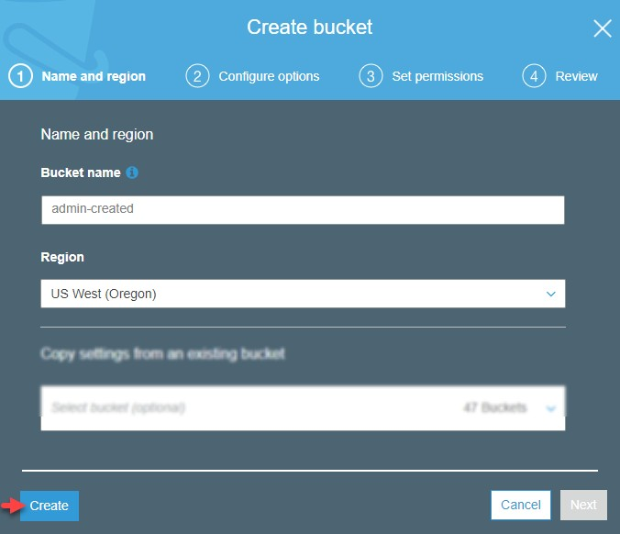
AWS Storage
Creation of S3 bucket
Create your own bucket name using the following naming guidelines:
The name must be unique across all existing bucket names in Amazon S3.
After you create the bucket you cannot change the name, so choose wisely.
Choose a bucket name that reflects the objects in the bucket because the bucket name is visible in the URL that points to the objects that you are going to put in your bucket.
For Region, choose US West (Oregon) as the region where you want the bucket to reside.
Choose Create.

Slide 12

AWS Storage
Properties for S3 bucket
Versioning – Versioning enables you to keep multiple versions of an object in one bucket. By default, versioning is disabled for a new bucket.
Server access logging – Server access logging provides detailed records for the requests that are made to
your bucket. By default, Amazon S3 does not collect server access logs.
Static website hosting – You can host a static website on Amazon S3. To enable static website hosting,
choose Static website hosting and then specify the settings you want to use.
Object-level logging – Object-level logging records object-level API activity by using CloudTrail data events.
Tags – With AWS cost allocation, you can use bucket tags to annotate billing for your use of a bucket. A tag is
a key-value pair that represents a label that you assign to a bucket. To add tags, choose Tags, and then choose Add tag.
Transfer acceleration – Amazon S3 Transfer Acceleration enables fast, easy, and secure transfers of files
over long distances between your client and an S3 bucket.
Events – You can enable certain Amazon S3 bucket events to send a notification message to a destination
whenever the events occur. To enable events, choose Events and then specify the settings you want to use.
Requester Pays – You can enable Requester Pays so that the requester (instead of the bucket owner) pays for requests and data transfers.
12

Slide 13
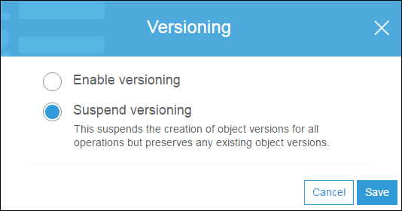
AWS Storage
AWS S3
To enable or disable versioning on an S3 bucket
Versioning enables you to keep multiple versions of an object in one bucket.
This section describes how to enable object
versioning on a bucket.

Slide 14
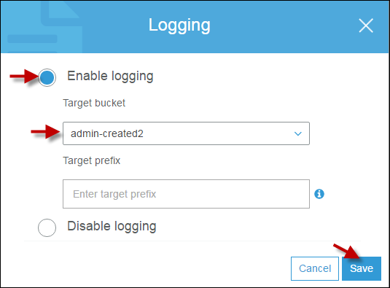
AWS Storage
How Do I Enable Server Access Logging for an S3 Bucket?
By default, Amazon Simple Storage Service (Amazon S3) does not collect server access logs.
When you enable logging, Amazon S3 delivers access logs for a source bucket to a target bucket that you choose.
The target bucket must be in the same AWS
Region as the source bucket.
Server access logging provides detailed records for the requests that are made to an S3 bucket.
Server access logs are useful for many applications. For example, access log information can be useful in security and access audits. It can also help you learn about your customer base and understand your Amazon S3 bill.

Slide 15
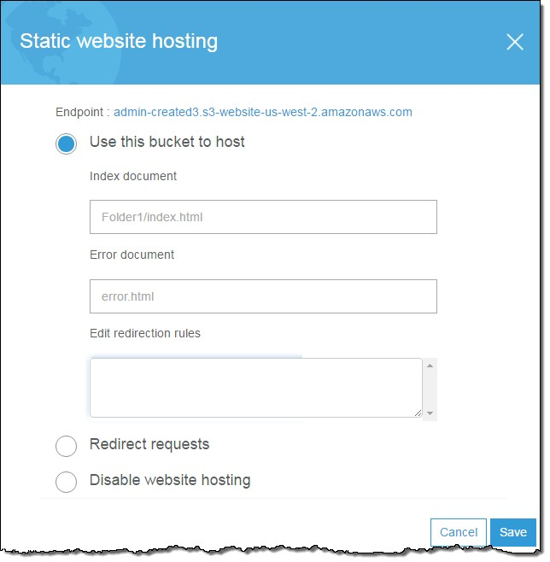
AWS Storage
Configure an S3 Bucket for Static Website Hosting
You can host a static website on Amazon S3.
On a static website, individual web pages include static content and they might also contain client-side scripts.
Amazon S3 does not support server-side scripting. In the Bucket name list, choose the name of the bucket that you want to enable static website hosting for.
Choose Properties
Choose Static website hosting
Choose Use this bucket to host
Choose Save
15

Slide 16
AWS Storage
Enable Object-Level Logging for an S3 Bucket with AWS CloudTrail Data Events
This section describes how to enable an AWS CloudTrail trail to log data events for objects in an
S3 bucket by using the Amazon S3 console.
CloudTrail supports logging Amazon S3 object-level API operations such as GetObject, DeleteObject, and PutObject.
These events are called data events. By default, CloudTrail trails do not log data events.
To configure a trail to log data events for an S3 bucket, you can use either the AWS CloudTrail console or the Amazon S3 console.

Slide 17
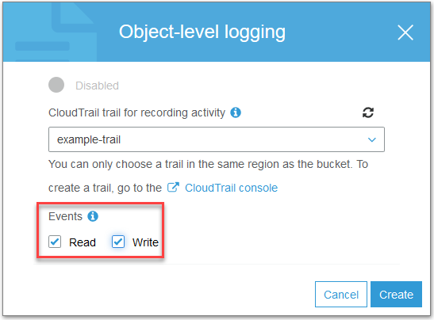
AWS Storage
In the Bucket name list, choose the name of the bucket that you want. Choose Properties. Choose Object-level logging. Choose an existing CloudTrail in the drop-down menu.
Under Events, select Read to specify that you want
CloudTrail to log Amazon S3 read APIs such
as GetObject. Select Write to log Amazon S3 write APIs such as PutObject. Select both Read and Write to log both read and write object APIs.
Choose Create to enable object-level logging for the
bucket.

Slide 18
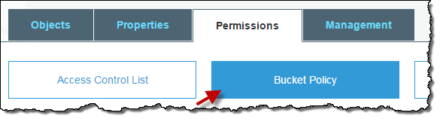
AWS Storage
Setting Permissions on Bucket
Setting ACL Bucket Permissions.
To grant access to your buckets and objects to other AWS accounts and to the general public, you use resource-based access policies called Access Control Lists (ACLs).
Adding a Bucket Policy
A bucket policy is a resource-based AWS Identity and Access Management (IAM) policy that grants other AWS accounts or IAM users access to an S3 bucket. Bucket policies supplement, and in many cases, replace ACL-based access policies.

Slide 19
AWS Storage
Add an S3 Bucket Policy
Fine grained Apply policies at the bucket level in S3.
Incorporate user restrictions without using
IAM.
In the Bucket name list, choose the name of the bucket that you want to create a bucket policy for or whose bucket policy you want to edit.
Choose Permissions, and then choose Bucket Policy.
In the Bucket policy editor text box, type or copy and paste a new bucket policy, or edit an existing policy. The bucket policy is a JSON file. The text you type in the editor must be valid JSON.
Choose Save.
The following example policy grants
the s3:GetObject permission to any public
anonymous users.
{
"Version":"2012-10-17",
"Statement":[
{
"Sid":"AddPerm",
"Effect":"Allow",
"Principal": "*",
"Action":["s3:GetObject"],
"Resource":["arn:aws:s3:::examplebucket/*"
]
}
]
}
19

Slide 20
AWS Storage
Set ACL Bucket Permissions
ACLs are resource-based access policies that grant access permissions to buckets and objects.
You can grant permissions to other AWS account users or to predefined groups.
The user or group that you are granting permissions to is called the grantee.
By default, the owner, which is the AWS account that created the bucket, has full permissions.
Each permission you grant for a user or group adds an entry in the ACL associated with the bucket.
The ACL lists grants, which identify the grantee and the permission granted.

Slide 21
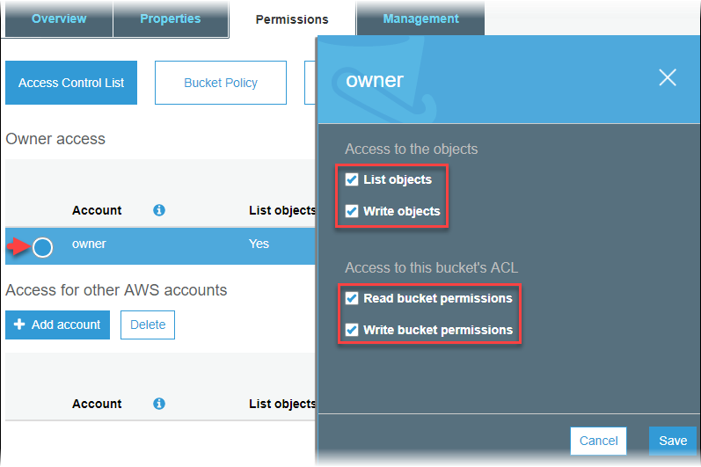
AWS Storage
You can manage bucket access permissions for the following:
Owner access
The owner refers to the AWS account root user, and not an AWS Identity and Access Management (IAM) user.
Access for other AWS accounts
To grant permissions to an AWS user from a different AWS account, under Access for other AWS accounts, choose Add account. In the Enter an ID field, type the canonical ID of the AWS user that you want to grant bucket permissions to.
Public access
To grant access to your bucket to the general public
(everyone in the world), under Public access,
choose Everyone. Granting public access permissions means that anyone in the world can access the bucket.

Slide 22
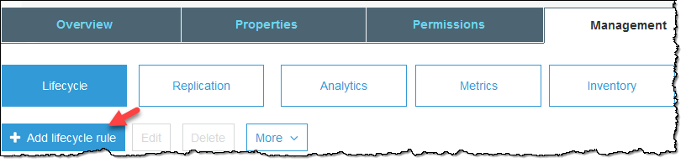
AWS Storage
Amazon S3 storage management tools
Creating a Lifecycle Policy
Creating Cross-Region Replication Rules
Managing Cross-Region Replication Rules
Configuring Storage Class Analysis
Configuring Amazon S3 Inventory
Configuring Request Metrics
Configuring a Request Metrics Filter

Slide 23
AWS Storage
EBS (Amazon Elastic Block Store)

Slide 24
AWS Storage
An Amazon EBS volume is a durable, block-level storage device that you can attach to a single EC2
instance.
Benefits of Using EBS Volumes are:
Data availability: When you create an EBS volume in an Availability Zone, it is automatically
replicated within that zone to prevent data loss due to failure of any single hardware component.
Data persistence: An EBS volume is off-instance storage that can persist independently from the life of an instance. You continue to pay for the volume usage as long as the data persists.
Data encryption: All EBS volume types support encryption. You can use encrypted EBS volumes to meet a wide range of data-at-rest encryption requirements for regulated/audited data and applications.
Snapshots: Amazon EBS provides the ability to create snapshots (backups) of any EBS volume and write a copy of the data in the volume to Amazon S3, where it is stored redundantly in multiple Availability Zones.
Flexibility: EBS volumes support live configuration changes while in production. You can modify
volume type, volume size, and IOPS capacity without service interruptions.
24

Slide 25
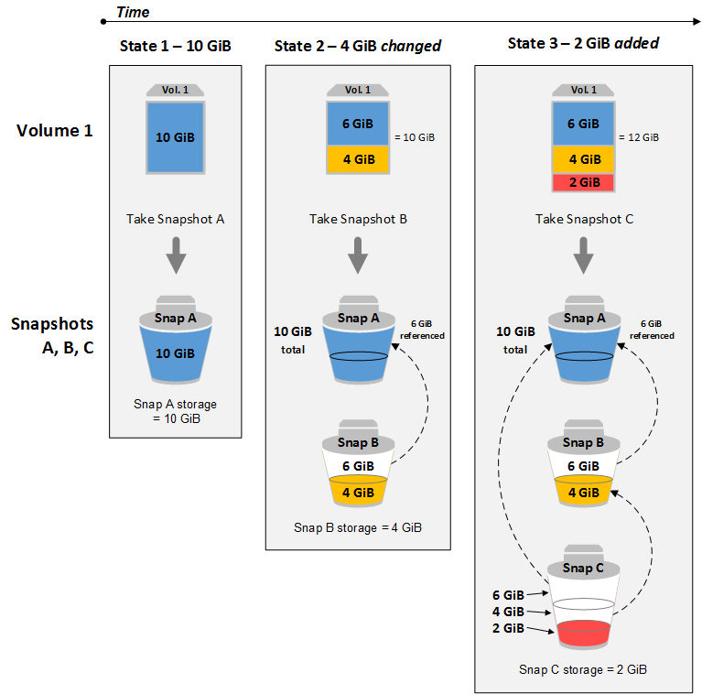
AWS Storage
Amazon EBS Snapshots
You can back up the data on your Amazon EBS volumes to Amazon S3 by taking point-in- time snapshots.
Snapshots
are incremental backups, which means that only the blocks on the device that have changed after your most recent snapshot
are saved.
24

Slide 26
AWS Storage
Glacier Storage Service
24

Slide 27
AWS Storage
What Is Amazon Glacier?
Amazon Glacier is a storage service optimized for infrequently used data, or "cold data."
Amazon Glacier is an extremely low-cost storage service that provides durable storage with security features for data archiving and backup.
With Amazon Glacier, customers can store their data cost effectively for months, years, or even
decades.
It is designed to deliver 99.999999999% durability, and provides comprehensive security and
compliance capabilities that can help meet even the most stringent regulatory requirements.
Amazon Glacier provides query-in-place functionality, allowing you to run powerful analytics directly on your archive data at rest.
24

Slide 28
AWS Storage
Amazon Glacier Data Model
The Amazon Glacier data model core concepts include vaults and archives. Amazon Glacier is a REST-based web service. In terms of REST, vaults and archives are the resources. In addition, the Amazon Glacier data model includes job and notification-configuration resources. These resources complement the core resources.
Vault: Vault is a container for storing archives. When you create a vault, you specify a name and choose an AWS Region where you want to create the vault.
Archive: An archive can be any data such as a photo, video, or document and is a base unit of
storage in Amazon Glacier. Each archive has a unique ID and an optional description.
Job: Amazon Glacier jobs can perform a select query on an archive, retrieve an archive, or get an
inventory of a vault.
Notification Configuration: Amazon Glacier supports a notification mechanism to notify you when a job is complete. You can configure a vault to send notification to an Amazon Simple Notification Service (Amazon SNS) topic when jobs complete.
24

Slide 29
AWS Storage
Key features of Glacier
Data retrieval features: Amazon Glacier provides three retrieval features for your archives to meet varying
access time and cost requirements: Expedited, Standard, and Bulk retrievals.
Amazon Glacier Select: Amazon Glacier Select allows queries to run directly on data stored in Amazon Glacier without having to retrieve the entire archive.
AWS Snowball and Direct Connect integration
AWS Snowball can accelerate movement of large amounts of data into and out of AWS using portable
storage devices for transport.
AWS Direct Connect makes it easy to establish a high-bandwidth, dedicated network connection from your premises to AWS.
Vault Lock: Amazon Glacier Vault Lock allows you to easily deploy and enforce compliance controls on
individual Glacier vaults via a lockable policy.
Access control: Amazon Glacier uses AWS Identity and Access Management (IAM) to help you securely control access to AWS and your Amazon Glacier data.
Tagging support: Amazon Glacier allows you to tag your Glacier vaults for easier resource and cost
management.
29

Slide 30
AWS Storage
Key features of Glacier
Audit logs: Amazon Glacier supports audit logging with AWS CloudTrail, which records Amazon Glacier API calls for your account and delivers these log files to you.
Vault access policies: Vault access policies allow you to easily manage access to your individual Glacier vaults.
Vault inventory: Amazon Glacier maintains an inventory of all archives in each of your vaults for
disaster recovery or occasional reconciliation.
AWS software development kits (SDKs): Data upload and retrieval are done using the AWS SDKs
or the underlying Amazon Glacier API. Amazon Glacier is supported by the AWS SDKs for Java,
.NET, PHP, and Python (Boto).
Integrated lifecycle management with Amazon S3: Amazon Glacier works together with Amazon S3 lifecycle rules to help you automate archiving of Amazon S3 data and reduce your overall storage costs.

Slide 31
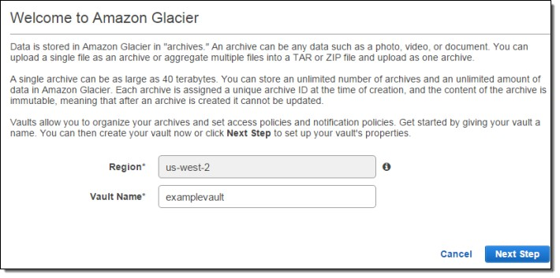
AWS Storage
Creating a Vault in Amazon Glacier
Creating a vault adds a vault to the set of vaults in your account. An AWS account can create up to
1,000 vaults per region.
Creating a Vault in Amazon Glacier using the AWS SDK for Java.
Creating a Vault in Amazon Glacier using the AWS SDK for .NET.
Creating a Vault in Amazon Glacier using the REST API.
Creating a Vault using the Amazon Glacier Console.

Slide 32
AWS Storage
Retrieve Vault Metadata for a Vault
You can retrieve metadata for a specific
vault or all the vaults in a specific region.
Following are the steps to retrieve vault metadata for a specific vault using the low- level API of the AWS SDK for Java.
The following Java code snippet illustrates the preceding steps.
DescribeVaultRequest request = new DescribeVaultRequest()
.withVaultName("*** provide vault name***"); DescribeVaultResult result = client.describeVault(request); System.out.print(
"\nCreationDate: " + result.getCreationDate() + "\nLastInventoryDate: " + result.getLastInventoryDate() + "\nNumberOfArchives: " + result.getNumberOfArchives() + "\nSizeInBytes: " + result.getSizeInBytes() +
"\nVaultARN: " + result.getVaultARN() + "\nVaultName: " + result.getVaultName());
Create an instance of
the AmazonGlacierClient class (the client).
Provide request information by creating an instance of
the DescribeVaultRequest class.
Execute the describeVault method by providing the request object as a parameter.

Slide 33
AWS Storage
Uploading an Archive in Amazon Glacier
Amazon Glacier provides a management console, which you can use to create and delete vaults.
However, you cannot upload archives to Amazon Glacier by using the management console.
To upload data, such as photos, videos, and other documents, you must either use the AWS CLI or write
code to make requests, by using either the REST API directly or by using the AWS SDKs.
Depending on the size of the data you are uploading, Amazon Glacier offers the following options:
Upload archives in a single operation – In a single operation, you can upload archives from 1 byte to up to 4 GB in size.
Upload archives in parts – Using the multipart upload API, you can upload large archives, up to
about 40,000 GB (10,000 * 4 GB).

Slide 34
AWS Storage
Retrieving Amazon Glacier Archives
Retrieving an archive from Amazon Glacier is an asynchronous operation in which you first initiate a job, and then download the output after the job completes. To initiate an archive retrieval job you use the Initiate Job (POST jobs) REST API or the equivalent in the AWS CLI, or AWS SDKS.
Archive Retrieval Options
You can specify one of the following when initiating a job to retrieve an archive based on your access time and cost requirements.
Expedited — Expedited retrievals allows you to quickly access your data when occasional urgent requests for a subset of archives are required. For all but the largest archives (250 MB+), data accessed using Expedited retrievals are typically made available within 1–5 minutes.
Standard — Standard retrievals allows you to access any of your archives within several hours. Standard retrievals typically complete within 3–5 hours.
Bulk — Bulk retrievals are Amazon Glacier’s lowest-cost retrieval option, which you can use to retrieve large amounts, even petabytes, of data inexpensively in a day. Bulk retrievals typically
complete within 5–12 hours.
34

Slide 35
AWS Storage
Dynamo DB
35

Slide 36
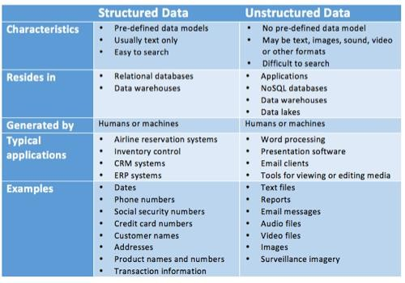
AWS Storage
Structured and Unstructured Data
Before going for Dynamo DB we need to understand the differences between structured and unstructured data.
Structured data is comprised of clearly defined data types whose pattern makes them easily searchable;
while unstructured data – “everything else” – is comprised of data that is usually not as easily searchable, including formats like audio, video, and social media postings.
35

Slide 37
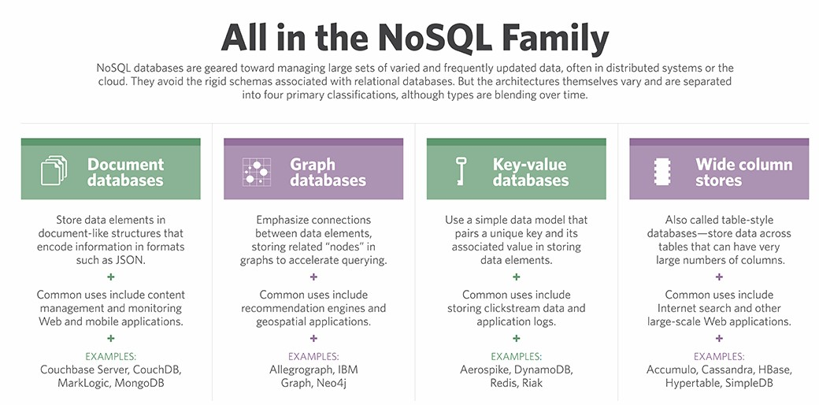
AWS Storage
NoSQL Database
NoSQL is an approach
to database design that can accommodate a wide variety of data models, including key-value, document, columnar and graph formats.
NoSQL, which stand for "not only SQL," is an alternative to
traditional relational databases in which
data is placed in tables and
data schema is carefully designed before
the database is built.
NoSQL databases are especially useful for working with large sets of distributed data.
35

Slide 38
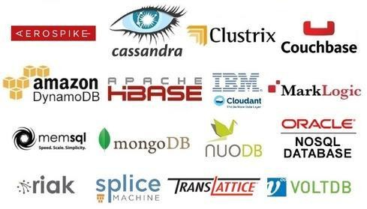
AWS Storage
Types of NoSQL Databases
A NoSQL database allows easy and quick retrieval of complex data and also ensures its availability on a consistent basis.
Since these are created on a distributed architecture, anomalies can be handled quickly and effectively; if a node goes down, others will continue operations without data loss thus ensuring consistent performance 24/7.
35

Slide 39
AWS Storage
What is Amazon DynamoDB?
Amazon DynamoDB is a fully managed NoSQL database service that provides fast and predictable performance with seamless scalability.
DynamoDB lets you offload the administrative burdens of operating and scaling a distributed database, so that you do not have to worry about hardware provisioning, setup and configuration, replication, software patching, or cluster scaling.
Also, DynamoDB offers encryption at rest, which eliminates the operational burden and complexity
involved in protecting sensitive data.
35

Slide 40
AWS Storage
Amazon DynamoDB Features
Performance at scale
Amazon DynamoDB Accelerator: Amazon DynamoDB Accelerator (DAX) delivers fast read performance for your DynamoDB tables at scale by enabling you to use a fully managed, highly available, in-memory cache.
Key-value and document data model support: DynamoDB supports key-value data structures that are designed to scale easily with a flexible schema.
Develop locally on your desktop: Download DynamoDB to develop and test applications locally
on your laptop or in an Amazon EC2 instance.
Secondary indexes: DynamoDB provides secondary indexes that give you the flexibility to efficiently query on any attribute (column).
Streams: Amazon DynamoDB Streams is a time-ordered sequence of item-level changes in any DynamoDB table.
Triggers: DynamoDB integrates with AWS Lambda to provide triggers.
35

Slide 41
AWS Storage
Amazon DynamoDB Features
Fully managed
Global tables: Global tables build on the global DynamoDB footprint to provide you with a fully managed, multi-region, and multi-master database that provides fast, local, read and write performance for massively scaled, global applications.
Point-in-time recovery: point-in-time recovery (PITR) provides continuous backups of your DynamoDB table data. When enabled, DynamoDB maintains incremental backups of your table for the last 35 days until you explicitly turn it off.
On-demand backup and restore: On-demand backup and restore allows you to create full backups of your DynamoDB tables’ data for data archiving, which can help you meet your corporate and governmental regulatory requirements.
Adaptive capacity: Adaptive capacity works by automatically increasing throughput capacity for partitions
that receive more traffic.
Auto scaling: DynamoDB delivers seamless, automatic scaling of throughput and storage scaling via APIs
and the AWS Management Console.
Time To Live: Time To Live (TTL) lets you set a specific time stamp to delete expired items from your tables.
35

Slide 42
AWS Storage
Amazon DynamoDB Features
Enterprise ready
Encryption at rest : Encryption at rest helps you secure your DynamoDB data by using AWS
managed encryption keys stored in AWS Key Management Service.
DynamoDB Service Level Agreement : AWS will use commercially reasonable efforts to make DynamoDB available for each AWS Region, during any monthly billing cycle, of at least 99.99% and as described in the Amazon DynamoDB Service Level Agreement.
Built-in high availability and durability : DynamoDB runs in proven Amazon data centres and automatically replicates data across three facilities in an AWS Region, giving you high availability and data durability.
Fine-grained access control : DynamoDB uses proven cryptographic methods to authenticate users and prevent unauthorized data access.
VPC endpoints : VPC endpoints for DynamoDB are logical entities within a VPC that create a private connection between a VPC and DynamoDB without requiring access over the internet, through a Network Address Translation (NAT) device, or a VPN connection.
Compliance : DynamoDB is in scope for the AWS Compliance programs such as SOC, PCI, ISO
and many more.
42

Slide 43
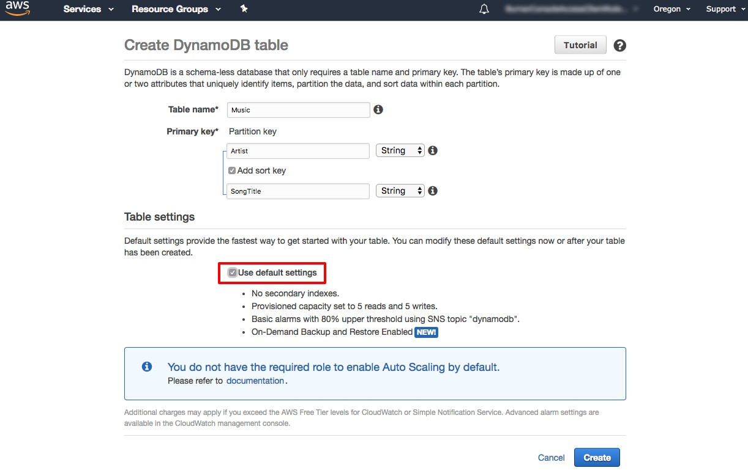
AWS Storage
Create a NoSQL Table
In the DynamoDB console, choose Create table.
We will use a music library as our use case for this tutorial.
In the Table name box, type Music.
The partition key is used to spread data across partitions for scalability. It is important to choose an attribute with a wide range of values and that is likely to have evenly distributed access patterns. Type Artist in the Partition key box
Because each artist may write many songs, you can enable
easy sorting with a sort key. Select the Add sort
key check box. Type song Title in the Add sort key box.
Next, you will enable DynamoDB auto scaling for your
table.
Scroll down the screen past Secondary indexes, Provisioned
capacity, and Auto Scaling to the Create button.
43

Slide 44
AWS Storage
RDS (Amazon Relational Database Service)
43

Slide 45
AWS Storage
Relational database service
Amazon Relational Database Service (Amazon RDS) is a web service that makes it easier to set up, operate, and scale a relational database in the cloud. It provides cost-efficient, resizable capacity for an industry-standard relational database and manages common database administration tasks.
Amazon RDS is available on several database instance types - optimised for memory, performance or I/O - and provides you with six familiar database engines to choose from, including Amazon Aurora, PostgreSQL, MySql, Maria DB, Oracle, Microsoft SQL server. We can use the AWS Database Migration Service to easily migrate or replicate your existing databases to Amazon RDS.
43

Slide 46
AWS Storage
Overview of Amazon RDS
When you buy a server, you get CPU, memory, storage, and IOPS, all bundled together. With Amazon RDS, these are split apart so that you can scale them independently. If you need more CPU, less IOPS, or more storage, you can easily allocate them.
Amazon RDS manages backups, software patching, automatic failure detection, and recovery.
To deliver a managed service experience, Amazon RDS does not provide shell access to DB instances, and it restricts access to certain system procedures and tables that require advanced privileges.
You can have automated backups performed when you need them, or manually create your own backup snapshot.
You can get high availability with a primary instance and a synchronous secondary instance that you can fail over
to when problems occur.
You can use the database products you are already familiar with: MySQL, MariaDB, PostgreSQL, Oracle, Microsoft SQL Server.
In addition to the security in your database package, you can help control who can access your RDS databases by using AWS Identity and Access Management (IAM) to define users and permissions.
You can also help protect your databases by putting them in a virtual private cloud.
46

Slide 47
AWS Storage
DB Instances
The basic building block of Amazon RDS is the DB instance.
A DB instance is an isolated database environment in the cloud.
A DB instance can contain multiple user-created databases, and you can access it by using the same
tools and applications that you use with a stand-alone database instance.
You can create and modify a DB instance by using the AWS Command Line Interface, the Amazon
RDS API, or the AWS Management Console.
Each DB instance runs a DB engine.
Amazon RDS currently supports the MySQL, MariaDB, PostgreSQL, Oracle, and Microsoft SQL Server DB engines.
Each DB engine has its own supported features, and each version of a DB engine may include
specific features.
Additionally, each DB engine has a set of parameters in a DB parameter group that control the behaviour of the databases that it manages.

Slide 48
AWS Storage
What is Amazon Aurora?
Amazon Aurora (Aurora) is a fully managed relational database engine that is compatible with
MySQL and PostgreSQL.
The code, tools, and applications you use today with your existing MySQL and PostgreSQL databases can be used with Aurora.
Aurora includes a high-performance storage subsystem.
Its MySQL- and PostgreSQL-compatible database engines are customised to take advantage of that fast distributed storage.
The underlying storage grows automatically as needed, up to 64 terabytes.

Slide 49
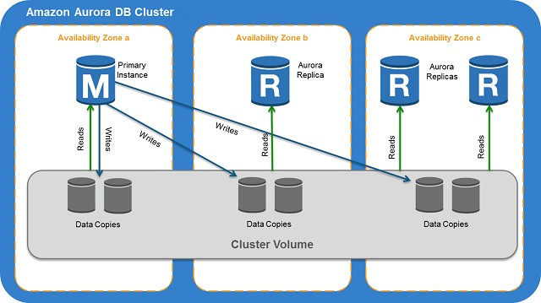
AWS Storage
Amazon Aurora DB Clusters
An Amazon Aurora DB cluster consists of one or more DB instances and a cluster volume that manages the data for those DB instances. An Aurora cluster volume is a virtual database storage volume that spans multiple Availability Zones, with each Availability Zone having a copy of the DB cluster data. Two types of DB instances make up an Aurora DB cluster:
Primary DB instance – Supports read and write operations, and performs all of the data modifications to the cluster volume. Each Aurora DB cluster has one primary DB instance.
Aurora Replica – Connects to the same storage volume as the primary DB instance and supports only read operations. Each Aurora DB cluster can have up to 15 Aurora Replicas in addition to the primary DB instance.

Slide 50
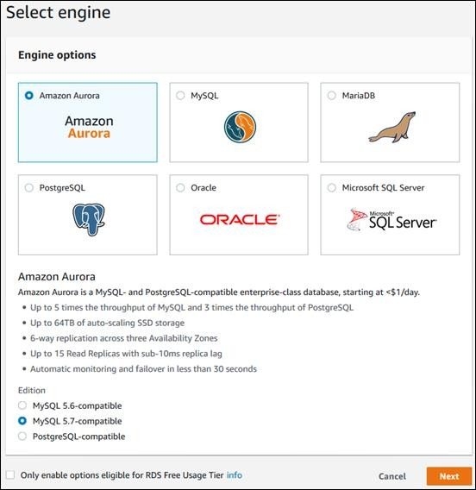
AWS Storage
To launch an Aurora MySQL DB cluster
Sign in to the AWS Management Console and open the Amazon RDS console at https://console.aws.amazon.com/rds/.
In the top-right corner of the AWS Management Console, choose the AWS Region that you want to create your DB cluster in. For a list of AWS Regions where Aurora is available.
In the navigation pane, choose Instances.
Choose Launch DB instance to start the Launch DB Instance wizard. The wizard opens on the Select engine page.
On the Select engine page, choose Amazon Aurora and choose the MySQL-compatible edition.

Slide 51
AWS Storage
To launch an Aurora MySQL DB cluster
Choose Next.
Set the following values on the Specify DB
details page:
DB instance class: db.r3.large
DB instance identifier: gs-db-instance1
Master username: Using alphanumeric characters, type a master user name, used to log on to your DB instances in the DB cluster
Master password and Confirm Password.
Choose Next and set the following values on the Configure Advanced Settings page:
Virtual Private Cloud (VPC)
Subnet group
Public accessibility: Yes
Availability zone: No Preference
VPC security groups
DB Cluster Identifier: gs-db-cluster1
Database name: sampledb
Database port: 3306
Leave the rest of the values as their defaults, and choose Launch DB instance to create the DB cluster and primary instance.

Slide 52
AWS Storage
Self Assessment Questions
Which one of the given options is the use of S3 in clouds?
Database
Server
Storage
Instance
Answer: Storage

Slide 53
AWS Storage
Self Assessment Questions
Which one of the given statement is true for an Amazon S3 bucket name?
Is account level unique
Is Region level unique
Is globally unique
Only i
Only ii
Only iii
All i, ii and iii
Answer: Only iii

Slide 54
AWS Storage
Self Assessment Questions
Which one of the given policy/permission is used to grant permissions to other AWS account users
or to predefined groups for S3 Buckets?
Bucket Policy
IAM users and groups
ACL Bucket Permissions
Answer: ACL Bucket Permissions

Slide 55
AWS Storage
Self Assessment Questions
Which one of the given statements is/are true for EBS Snapshots?
Are differential backups
Are Full backups
Are incremental backups
Only i
Only ii
Only iii
All i, ii and iii
Answer: Only iii

Slide 56
AWS Storage
Self Assessment Questions
Which one of the given options is not RDS service in AWS?
MSSQL
Oracle
MySQL
Dynamo DB
Answer: Dynamo DB

Slide 57
AWS Storage
Self Assessment Questions
Which one of the given statements is NOT true for Glacier Service?
Amazon Glacier is a storage service optimized for infrequently used data, or "cold data."
Amazon Glacier is an extremely low-cost storage service that provides durable storage with
security features for data archiving and backup.
With Amazon Glacier, customers can store their data cost effectively for months, years, or even
decades.
It is designed to deliver 99.9% durability
Answer: It is designed to deliver 99.9% durability

Slide 58
AWS Storage
Self Assessment Questions
An unstructured data does not reside in .
Applications
Relational Databases
NoSQL Databases
Data Lakes
Answer: Relational Databases

Slide 59
AWS Storage
Self Assessment Questions
8. Which one of the given statement is true for NoSQL Database?
NoSQL is an approach to database design that can accommodate a wide variety of data models, including key-value, document, columnar and graph formats.
NoSQL, which stand for "not only SQL," is an alternative to traditional relational databases in which data is placed in tables and data schema is carefully designed before the database is built.
NoSQL databases are especially useful for working with large sets of distributed data.
iii.
Only i
Only ii
Only i and ii
All i, ii and iii
Answer: All i, ii and iii
59

Slide 60
AWS Storage
Self Assessment Questions
Which one of the given options is not a NoSQL Database?
DynamoDB
Amazon Aurora
IBM Cloudant
Mongo DB
Answer: Amazon Aurora
60

Slide 61
AWS Storage
Self Assessment Questions
10. Which one of the given statement is true for Amazon RDS database(DB) instance?
A DB instance can contain multiple user-created databases, and you can access it by using the
same tools and applications that you use with a stand-alone database instance.
You can create and modify a DB instance by using the AWS Command Line Interface, the Amazon RDS API, or the AWS Management Console.
Amazon RDS currently supports the MySQL, MariaDB, PostgreSQL, Oracle, and Microsoft
SQL Server DB engines.
iii.
Only i
Only ii
Only i and ii
All i, ii and iii
Answer: All i, ii and iii
61

Slide 62
AWS Storage
Self Assessment Questions
11. Which statements are true for an archive?
An archive is a durably stored block of information.
You store your data in Amazon Glacier as archives.
You may upload a single file as an archive, but your costs will be lower if you aggregate your
data.
All of the above
Answer: All of the above

Slide 63
AWS Storage
Self Assessment Questions
12. are common formats that customers use to aggregate multiple files into a single file before uploading to Amazon Glacier.
TAR and ZIP
ZIP Files Only
TAR files only
None of the above
Answer: TAR and ZIP

Slide 64
AWS Storage
Self Assessment Questions
13. What is the minimum amount of data that I can store using Amazon Glacier?
1 Byte
No minimum Limit
1 GB
40 TB
Answer: No minimum Limit

Slide 65
AWS Storage
Self Assessment Questions
14. How many databases or schemas can I run within a DB instance of SQL?
No limit imposed by software
1 database per instance; no limit on number of schemas per database imposed by software
30 databases per instance
None of the above
Answer: 30 databases per instance

Slide 66
AWS Storage
Self Assessment Questions
15. What happens when I convert my RDS instance from Single-AZ to Multi-AZ?
A snapshot of your primary instance is taken
A new standby instance is created in a different Availability Zone, from the snapshot
Synchronous replication is configured between primary and standby instances
All of the above
Answer: All of the above

Slide 67
AWS Storage
Assignment
Make document to create a bucket and hosting a static website?
What is AWS cloud storage?
Prepare document on structured and unstructured data.
List and explain the various NoSQL database engine.
Create a table in DynamoDB for 10 students and write a query to get the students information using student ID as primary key.
What is RDS? Explain different services of RDS.
Make a document to create MySQL database using RDS.
Make a document to create Amazon Aurora database using RDS.

Slide 68
AWS Storage
Summary
Introduction to S3 and its properties.
The S3 bucket creation and hosting the static website.
Creating and configuring Glacier storage Service.
Creating and configuring the Dynamo DB database.
Creating table and writing query to get the required information from the table.
Understanding the difference between structured and unstructured data.
Relational database service and different database engines supported by AWS RDS.

Slide 69
AWS Storage
Document Links
Topic | URL | Notes
AWS S3 | https://docs.aws.amazon.com/AmazonS3/latest/dev/Introduction.html https://docs.aws.amazon.com/AmazonS3/latest/dev/Welcome.html | What is SSS(s3)?
S3 bucket | https://docs.aws.amazon.com/sdk-for-go/v1/developer-guide/s3-example- basic-bucket-operations.html | S3 bucket creation
S3 Bucket Properties | https://docs.aws.amazon.com/AmazonS3/latest/dev/EnableWebsiteHosting. html | Web hosting in S3 bucket
AWS RDS | https://aws.amazon.com/rds/ https://docs.aws.amazon.com/AmazonRDS/latest/UserGuide/Welcome.html | RDS Engines
Glacier Storage | https://docs.aws.amazon.com/amazonglacier/latest/dev/glacier-dg.pdf | Glacier Storage
DynamoDB | https://docs.aws.amazon.com/amazondynamodb/latest/developerguide/dyn amodb-dg.pdf | DynamoDB

Slide 70
AWS Storage
Video Links
Topic | Video URL | Note
AWS S3 | https://www.youtube.com/watch?v=77lMCiiMilo | Introduction to S3
S3 Bucket Properties | https://www.youtube.com/watch?v=1IWnzK6LN3E& t=4s | creating web server using S3
AWS Glacier | https://www.youtube.com/watch?v=jQR9JpVKc2A | Glacier
AWS RDS | https://www.youtube.com/watch?v=I9Fzm1obG7U | Relational database service
NoSQL | https://www.youtube.com/watch?v=2mVR_Qgx_RU | NoSQL - DynamoDB

Slide 71
AWS Storage
E-book references
Web Link | Topic Name | Page Numbers
https://awsdocs.s3.amazonaws.com/gettingstarted/latest/awsgsg- intro.pdf | S3 | 17-23
http://index- of.es/Miscellanous/LIVRES/Wiley.NoSQL.Mar.2015.ISBN.111890574 1.pdf | NoSQL | 5-59
http://iips.icci.edu.iq/images/exam/databases-ramaz.pdf | Database | 29-52
https://docs.aws.amazon.com/amazonglacier/latest/dev/glacier- dg.pdf | Glacier | 1-20

